Slide 1
Detecting Cancer in Gigapixel Pathology Images
Su Ji Park
Ashish Maheshwari
Tia Lim

Slide 2
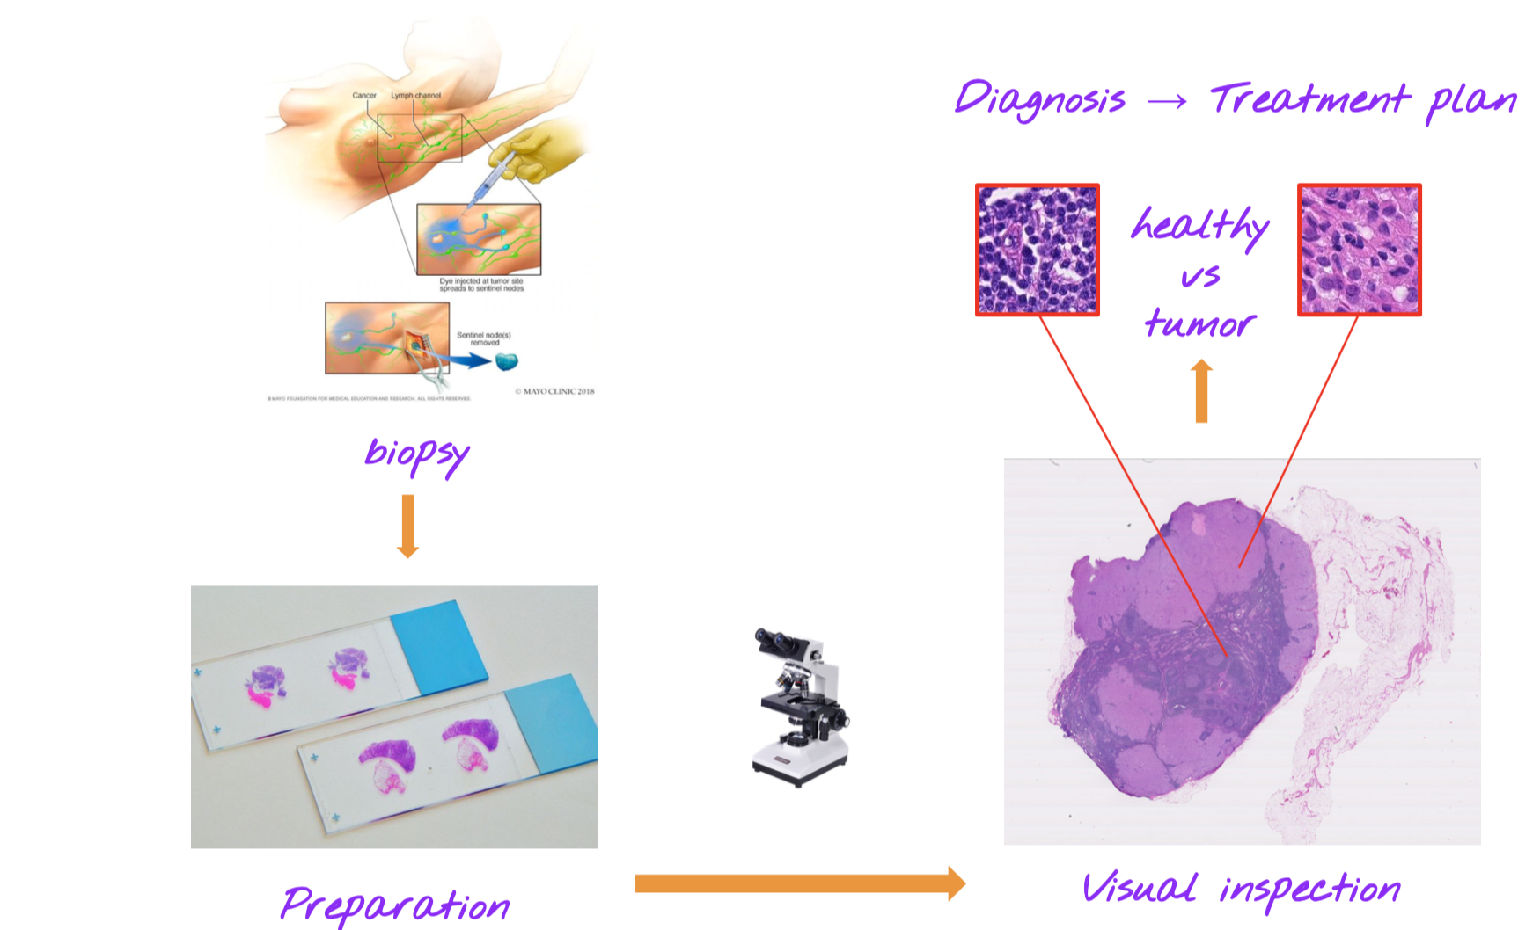
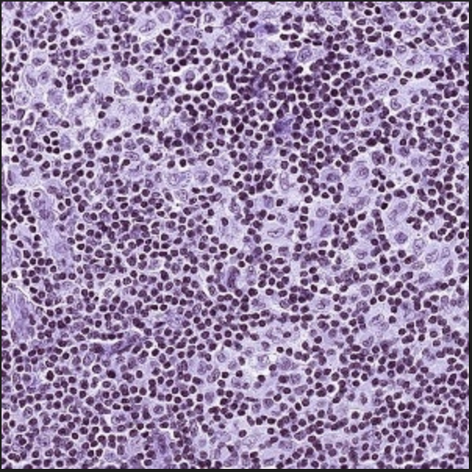
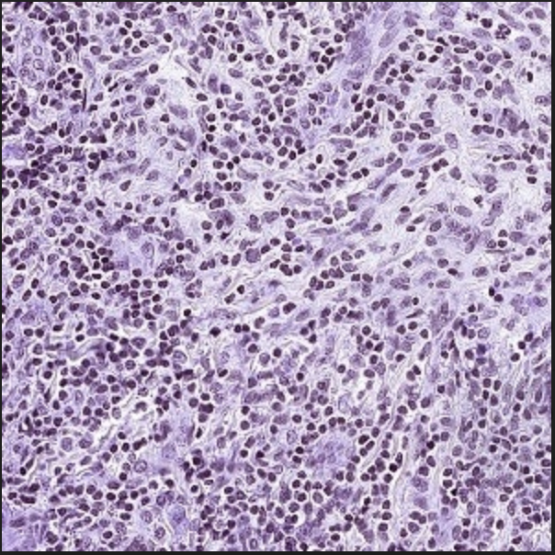
Background
Biopsy (tissue core) of lymph nodes to see if cancer is spreading
Purpose: Assist not automate pathologist by classifying whether the image contains tumor and localizing the tumors for a pathologists.
Difficult to tell tumor vs. no tumor with naked eye
Level 2, no tumor
Level 2, tumor

Slide 3
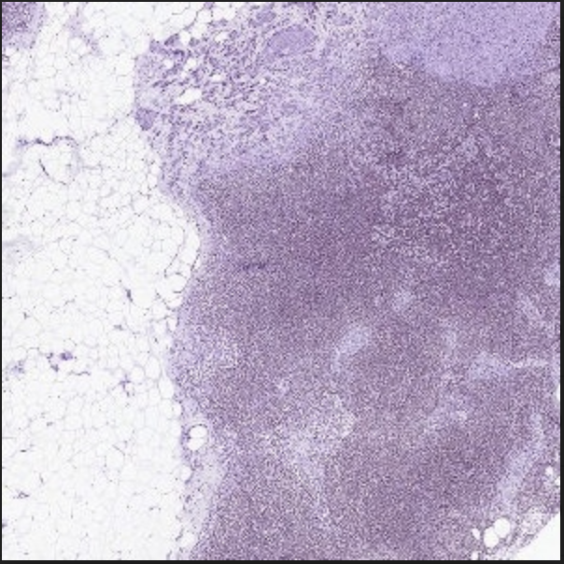
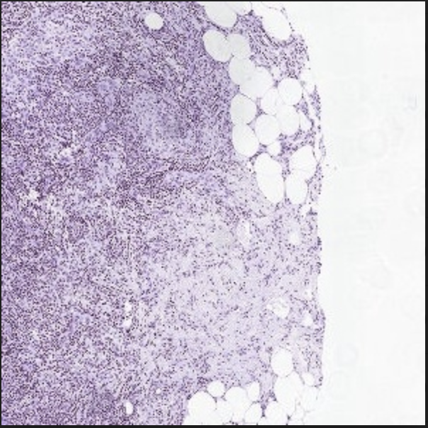
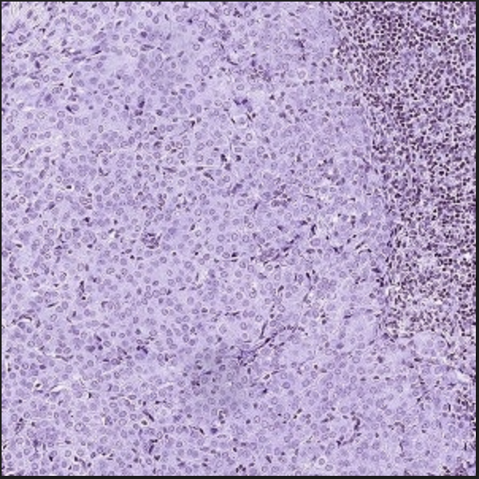
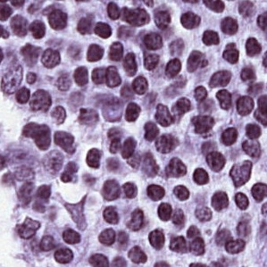
Preprocessing Dataset
Camelyon17 dataset
gigapixel pathology image (.tiff)
up to 8 zoom level
Capture context as well as detail
Extracted 299x299 windows with at least 30% non-gray region at multiple zoom levels.
Level 5
Level 4
Level 3
Level 2
Level 1

Slide 4
Data Preprocessing for Unbalanced Dataset
We tried 2 techniques for balancing the data and finally ended up using the second. They are:
Class Weighting
Assign class weights for tumor, non-tumor data based on size of the dataset.
Class weights are applied to loss function
Artificially Downsampling No Tumor
Since no-tumor data was substantially more than the tumor data, we randomly dropped no-tumor images to match the number of tumor images.

Slide 5
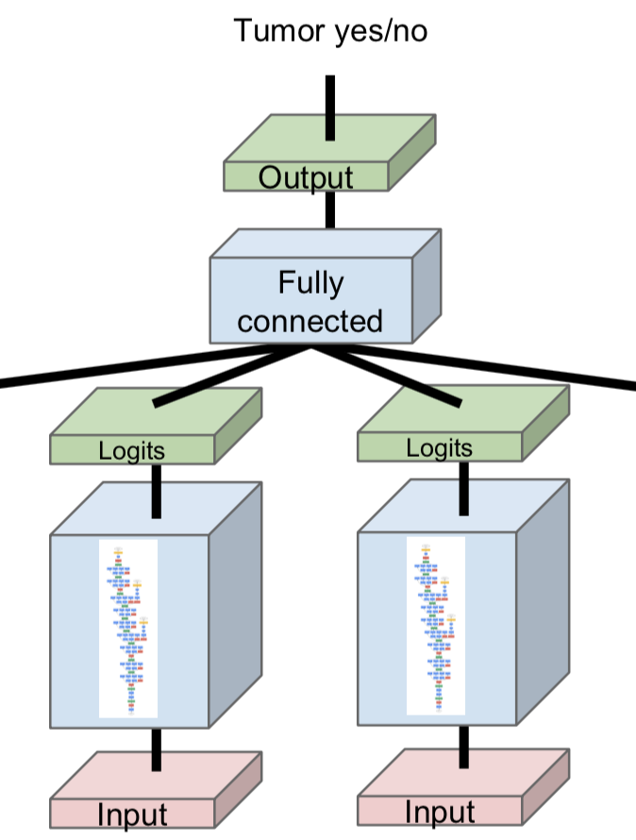
Model Architecture
Transfer learning: Inception V3
Custom model: Binary image classification using CNN.
Multi-Zoom model: Inception V3 used as base layer and then connected a Fully Connected Dense layer before the final sigmoid for binary classification.
Level 3
Level 2
Notes:
According to the paper, they figured that heavy models, such as VGG16, is not required.
Transfer learning was not helpful

Slide 6
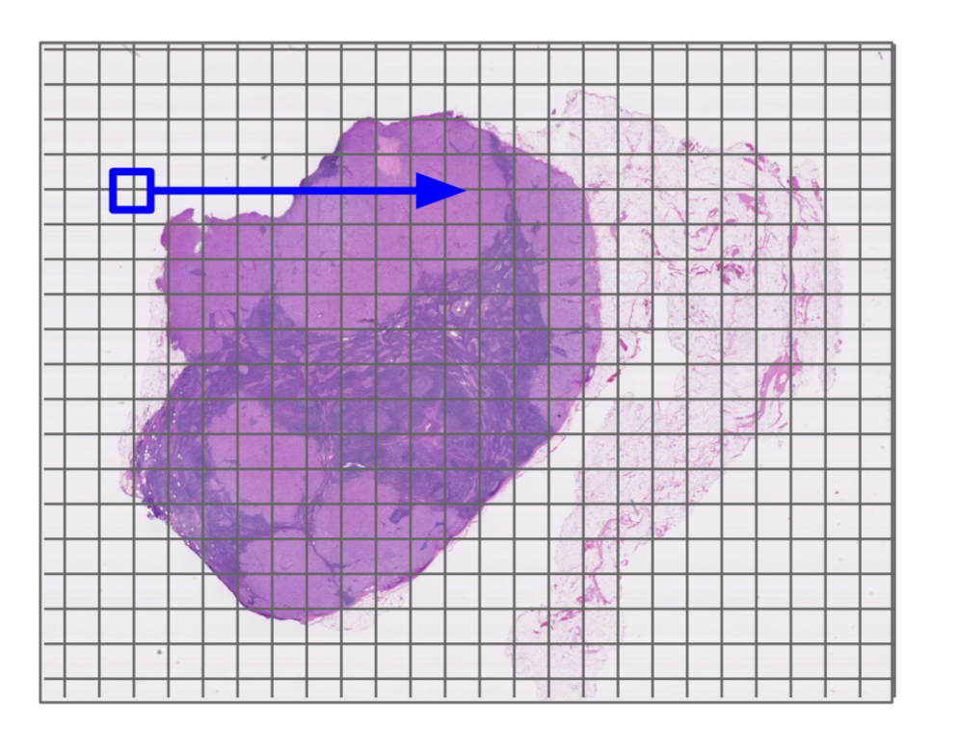
Heatmap
Notes:
Now we will briefly explain how we generated the heat map, and give a demonstration on how to use the heatmap code to generate heatmaps for any model, and any slide to see the model’s predictions on that slide.
To generate the heatmap, we used a sliding window of size 299 by 299 pixels over the slides. The step size at which the window was sliding over the slide can be easily controlled. For each window, we used our model to generate a prediction, and add the prediction to the heatmap.

Slide 7
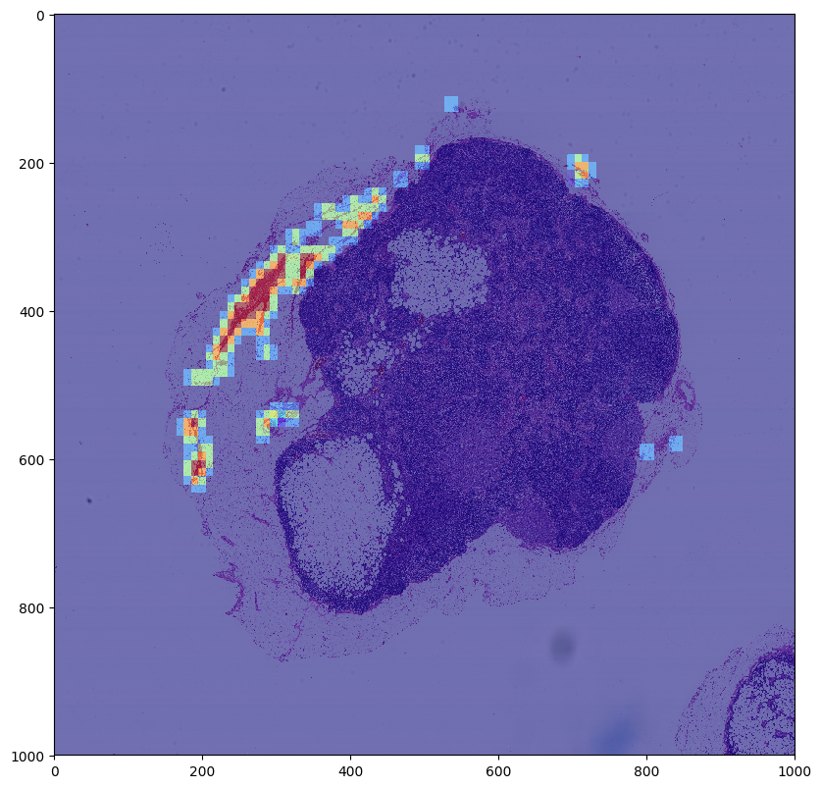
Heatmap
*our final model was not used to generate this heat map
Notes:
As you can see, this is an example of a heatmap generated for a slide, with step-size 150. By adding the prediction value to each window on the heatmap, we get a gradient of colors, where the color red represents the areas of the heatmap with the highest probability of containing a tumour, as predicted by our model.

Slide 8
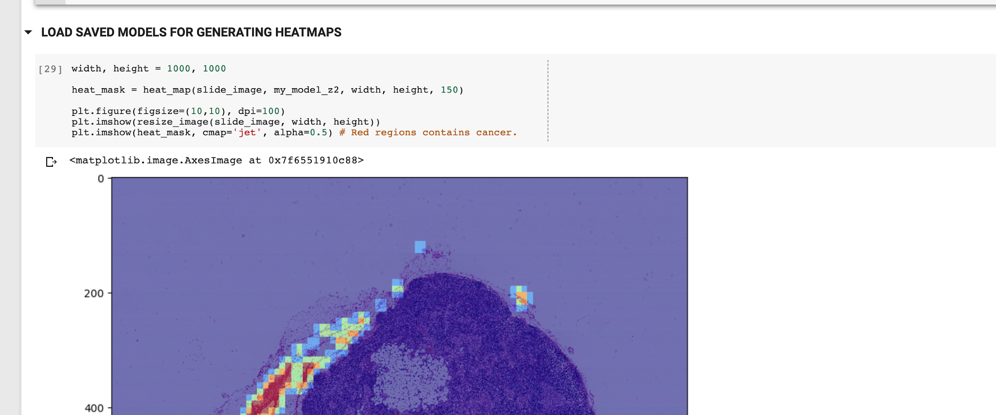
Heatmap
Notes:
This cell is also in the heatmap notebook, used to generate the heatmap for tumour slide 91. We specify a width and height of 1000 pixels, and a stride value of 150.
We obtain the heatmap by calling the heat_map function with a model trained on patches of zoom level two, and overlay the heatmap over the original slide, which also has been downsized to 1000 by 1000 pixels.

Slide 9
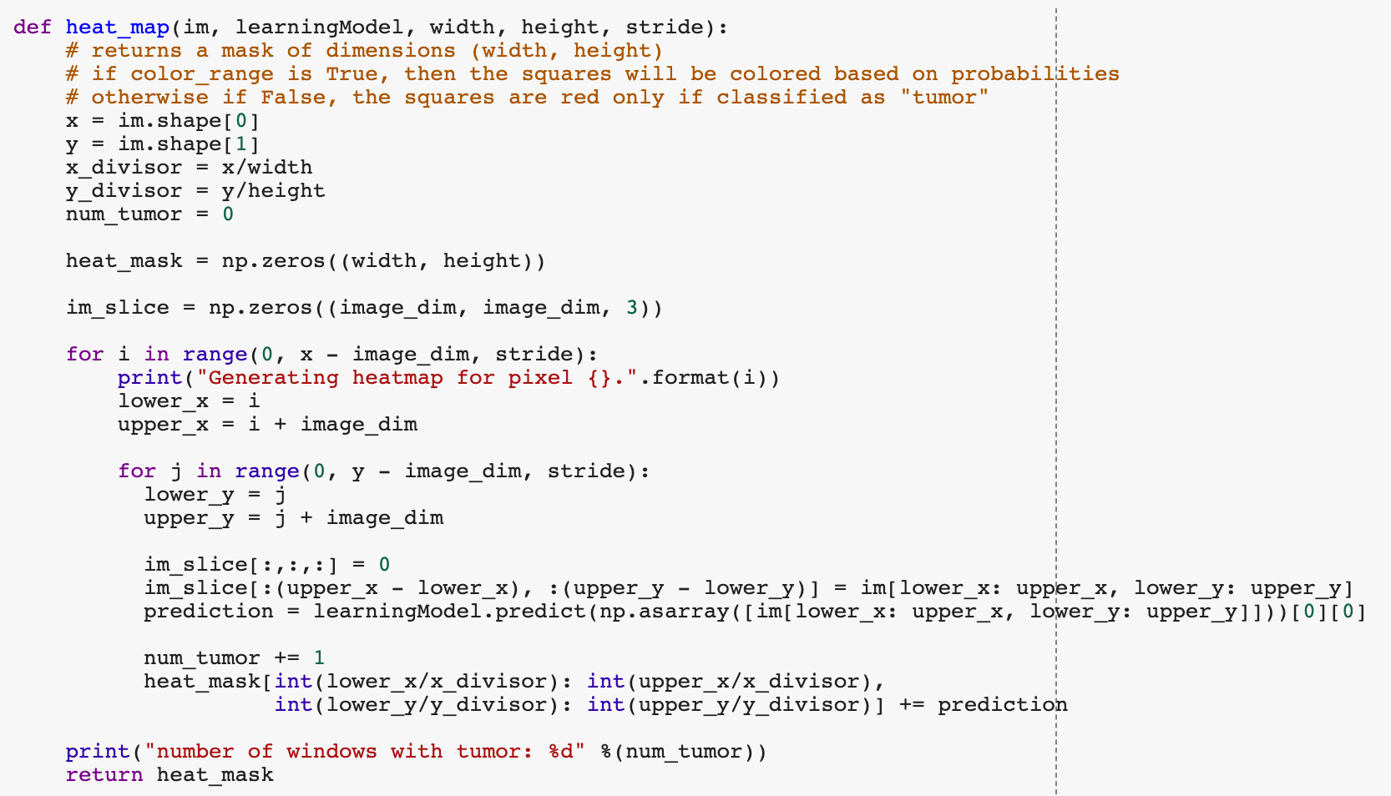
Heatmap
Notes:
This code can be found in the heatmap notebook on the github repo.
Our heatmap function takes the slide image, the model used to generate predictions, the desired width and height of the final heat_map, and the stride, or step-size of the sliding window. So for lower stride values, we expect a finer, more resolved heatmap, but this also takes a longer time to generate.
This part of the code shows our sliding window of size image_dim, which we have set at 299, taking a step size specified by the stride parameter.
Finally, we add the model’s prediction value to our heatmap, which is downsized according to the width and height parameters.

Slide 10
Accuracy and Loss
Plots

Slide 11
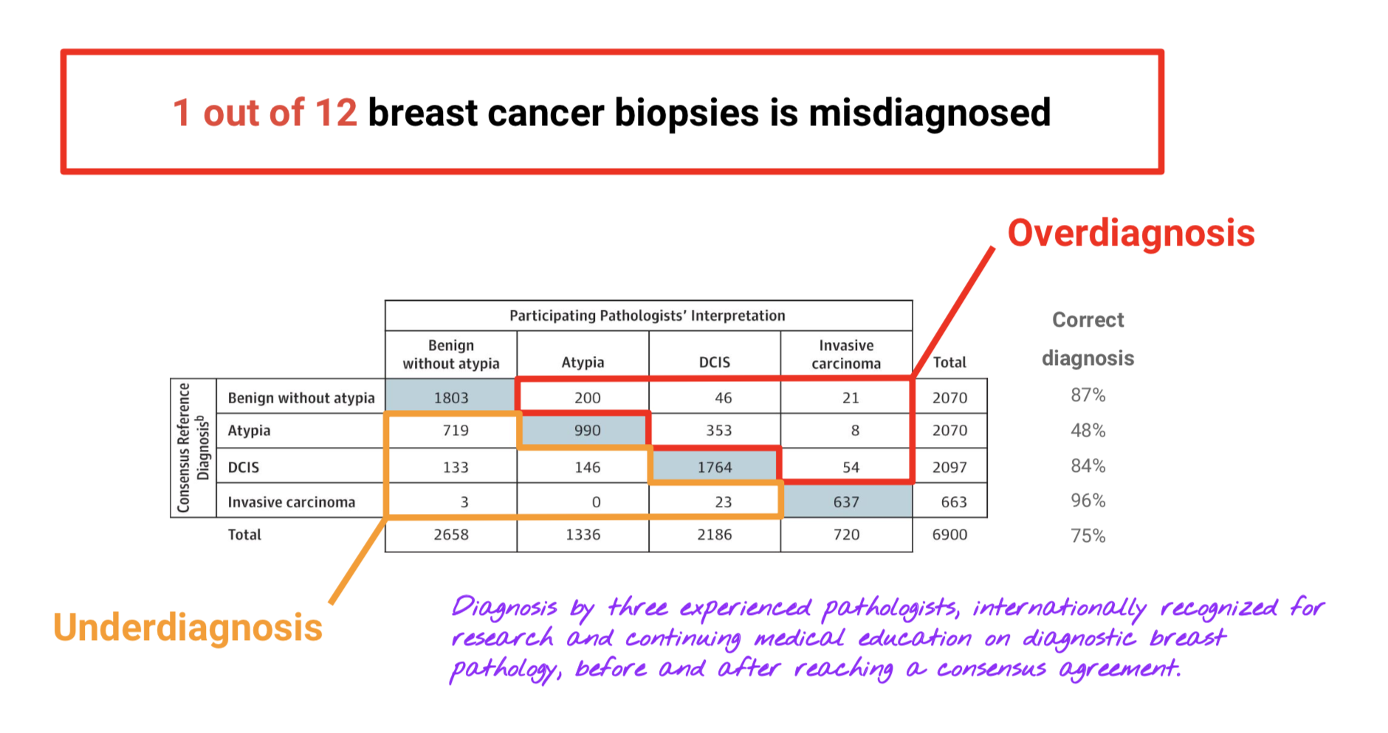
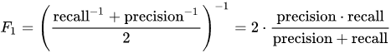
Evaluation Metric
We care about reducing false negative rate, or predicting no tumor, but the patient actually has tumor
Confusion Matrix
F1-Score (average of precision and recall)
Notes:
Justification how well my model is working

Slide 12
Evaluation Metric
TP = True Positives
FP = False Positives
TN = True Negatives
FN = False Negatives
Recall/Sensitivity:
Also known as the True Positive Rate
TP/(TP + FN)
Crucial score as we want patients who have tumor to be alerted that they need treatment
Specificity:
Also known as the True Negative Rate
TN/(TN+FP)
Precision:
Also known as the Positive Predictive Value
TP / (TP + FP)
Saves cost by reducing unnecessary treatment
Notes:
The sensitivity we believe is our most important metric, as this basically says that given that a patient has tumour, our model will say that the patient’s slides contains tumour patches with high probability. This is essential in quickly alerting patients that they should seek quick treatment.
The specificity is another metric, which is the percentage of correctly predicted non tumour slides in the pool of slides that are classified no tumor.
We will also consider precision. High precision says that most of the patients who receive a positive prediction have tumor. This helps the hospital and patients save costs by reducing the need for unnecessary treatment and tests, as only the patients who need treatment receive it.

Slide 13
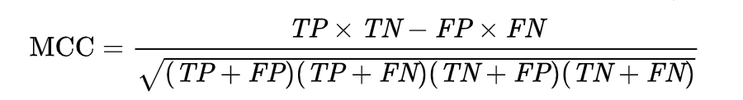
Evaluation Metric
TP = True Positives
FP = False Positives
TN = True Negatives
FN = False Negatives
Negative Predictive Value:
TN/(TN+FN)
Representative of the reliability of the model
F1 Score
2 * Precision * Recall / Precision + Recall
Weighted average of precision and recall
More important than accuracy since FN are more severe than FP
Matthews Correlation Coefficient:
Measure accuracy for unbalanced datasets
[-1, 0, 1]
Notes:
We will also consider Negative Predictive Value, which is the percentage of true negatives in the pool of predicted negative value. This is also an important metric, though we believe may not be as crucial as sensitivity. High predictive value essentially increases the reliability of the model, by saying that if the model classifies a patient’s slides as having no tumor, the patient very likely does not have tumor.
The F1 score is a better indicator of accuracy than vanilla accuracy in our problem, since in our problem, the severity of having false negatives is higher than that of false positives. A false negative will send a sick patient home, whereas a false positive simply requires a healthy patient to be further verified by a specialist. Therefore, we will pay closer attention to this metric.
The last metric we will compute is the Matthews Correlation Coefficient, which is best used for imbalanced data sets. It penalizes wrong classifications in both classes according to different weights. The metric ranges from -1 to 1, where 0 represents “no better than random classification” and 1 represents perfect classification, -1 represents total disagreement.

Slide 14
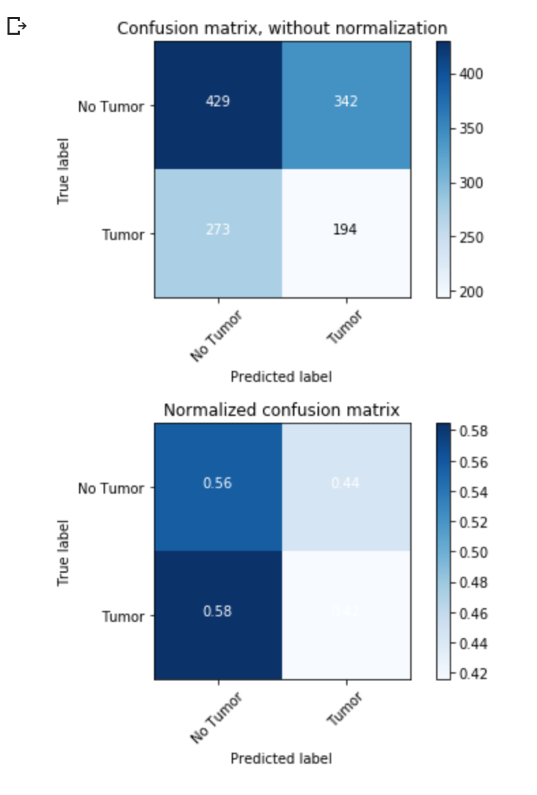
Model: Inception V3 | Zoom Level: 2 | Epochs: 20
Recall/Sensitivity | 0.415
Specificity | 0.556
Precision | 0.361
Negative Predictive Value | 0.611
F1 | 0.387
Accuracy | 0.503
MCC | -0.0275
Notes:
We trained the 3 models using our dataset. Here are the results for the 3 models, the viewer can pause at the specific slide for details. I will compare the metrics for the 3 models side by side.

Slide 15
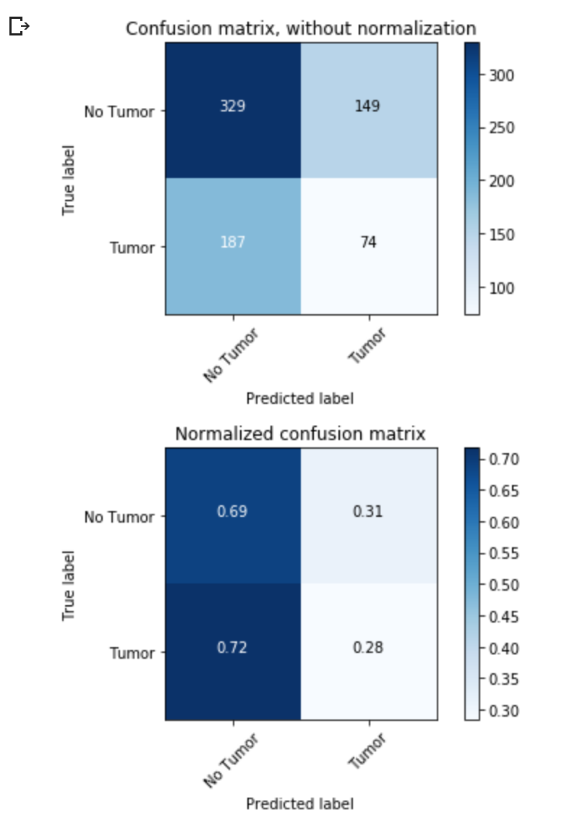
Model: Custom CNN | Zoom Level: 3 | Epochs: 15
Recall/Sensitivity | 0.283
Specificity | 0.688
Precision | 0.331
Negative Predictive Value | 0.637
F1 | 0.306
Accuracy | 0.545
MCC | -0.029

Slide 16
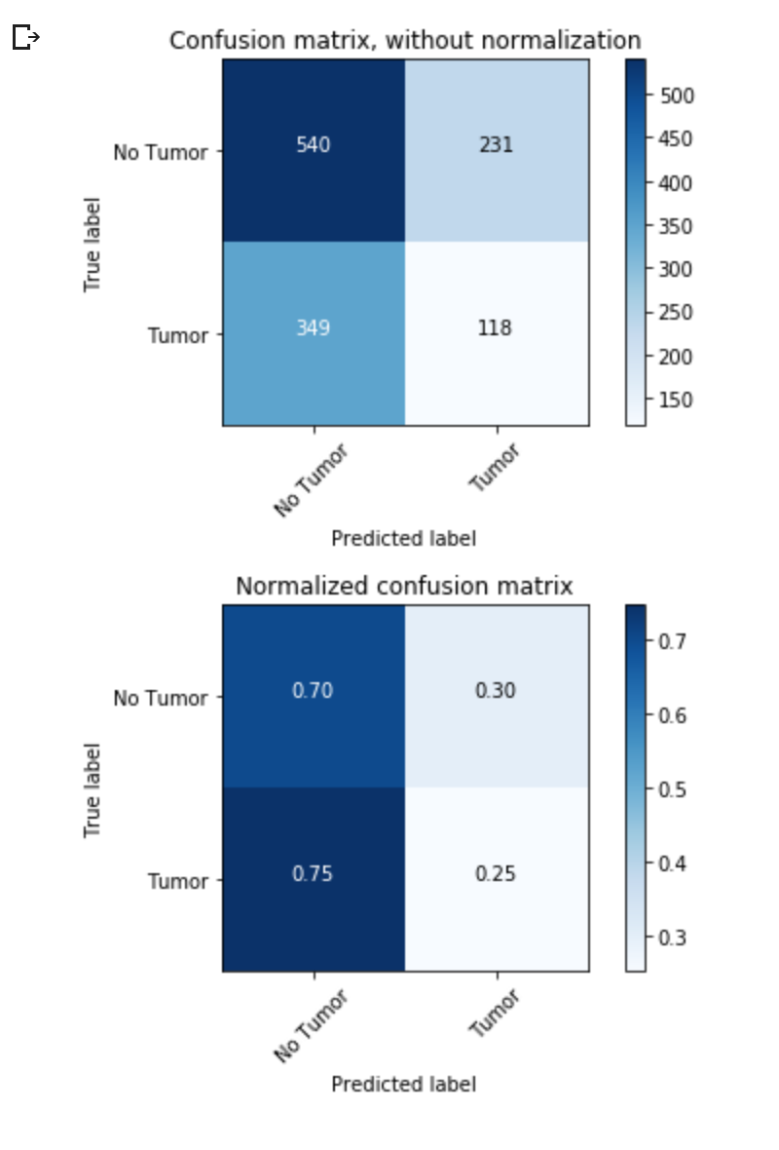
Model: Custom CNN | Zoom Level: 2 | Epochs: 15
Recall/Sensitivity | 0.252
Specificity | 0.700
Precision | 0.338
Negative Predictive Value | 0.607
F1 | 0.289
Accuracy | 0.531
MCC | -0.050
Notes:
We trained 3 different models

Slide 17
Comparing Metrics
Metric | Inception V3 at Z2 | Custom CNN at Z2 | Custom CNN at Z3
Recall/Sensitivity | 0.415 | 0.252 | 0.283
Specificity | 0.556 | 0.700 | 0.688
Precision | 0.361 | 0.338 | 0.331
Negative Predictive Value | 0.611 | 0.607 | 0.637
F1 | 0.387 | 0.289 | 0.306
Accuracy | 0.503 | 0.531 | 0.545
MCC | -0.0275 | -0.050 | -0.029
Notes:
These are the metrics for all our 3 models, side by side.
Even at first glance, we can tell all our 3 models are highly inaccurate and should not be used in practice to classify patient information. Regardless, we will examine each metric in closer detail.
As we had mentioned earlier, sensitivity was our key metric and this suggests that our inception model at zoom level 2 was the most accurate, at 41.5%. However, this is still highly inaccurate and should not be used by any means. While specificity for our custom CNN at Zoom level 2 is high, which means that it classifies 70% of non-tumor slides correctly, this is outweighed by its low sensitivity metric. Therefore, this model should also not be used.
All 3 models have precision at about 33%, which means of all the positive tumor patches predicted, 33% of them actually contain tumor. In the same vein, negative predictive value falls around 61%, which means that of all the negative patches predicted, 61% of them actually do not contain tumor. This is definitely a cause for concern.
Due to undersampling, we ensured that there was the same number of tumor and non-tumor patches. We suspect that our model may simply be a close to “random” model, which outputs its prediction at random, as can be shown by the close-to-50% accuracy, and close-to-0 MCC metric. In fact, the metrics for all 3 models are negative, saying that our models are mostly disagreeable with the correct labels.
The F1-score for all 3 models are too low, with the highest for the inception model at 38.7%. This is also an indicator for why none of our models should be used.

Slide 18
Possible Sources of Error
Too small a tissue threshold (30% vs 70% in paper)
We did this to increase dataset size
Too small dataset due to undersampling
Using class weights still gave us too low sensitivity/recall
Wrongly preprocessed (?!)
Notes:
We realize that our model is highly inaccurate, and despite hyperparameter tuning, found that we could not significantly improve the accuracy of our model significantly. We therefore want to discuss possible sources of error of our model, so that we can address these probable sources in future work.
One source of error could be due to our tissue threshold, of 30%, being too small. The reason for choosing a small threshold was to increase the sources of training data. However, this also led to our training set perhaps containing too many patches with too little tissue information, that might have interfered with the training process.
Another could be that our dataset was too small to train on due to undersampling, where we had to throw out many non-timor patches. We were left with 2000 patches in each class for the zoom level 2 dataset, for example.
One last possible grave source of error might be that dataset might be been pre-processed and labelled wrongly, therefore arising to the the model learning wrong labels. However, we do believe this is unlikely after having overviewed our code base.

Slide 19
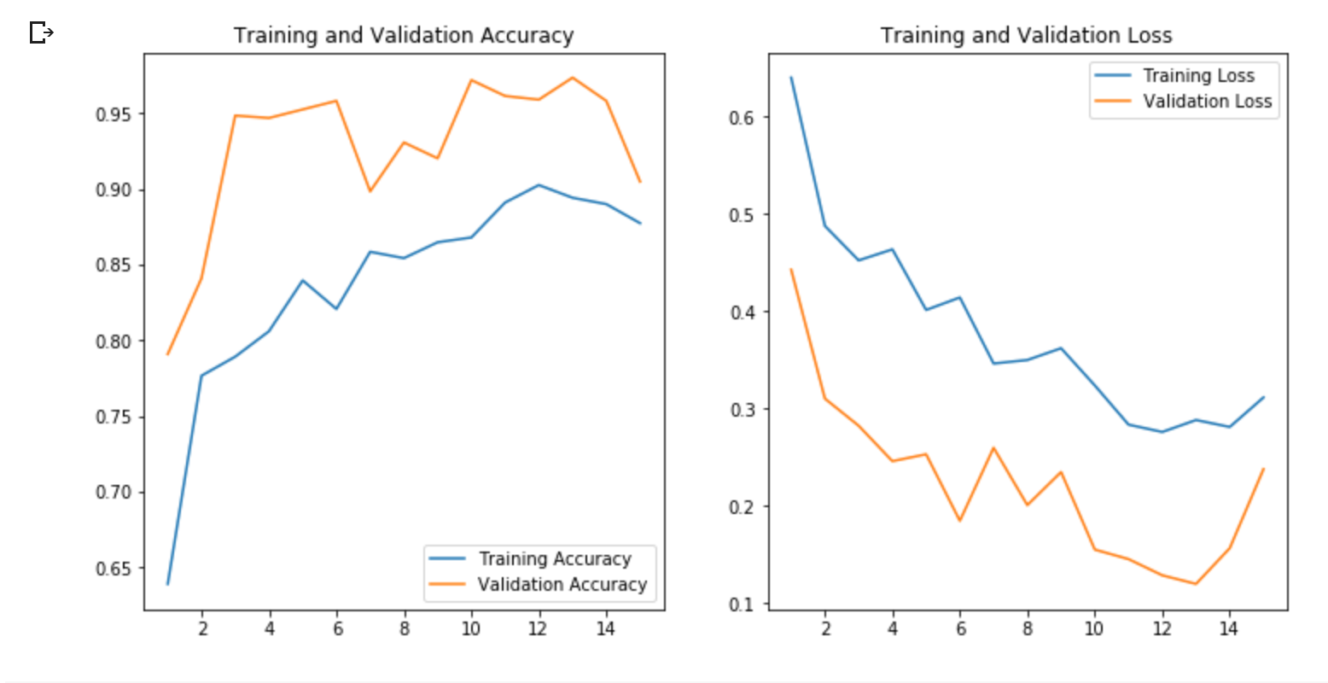
Model: Custom CNN | Zoom Level: 2 | Epochs: 15

Slide 20
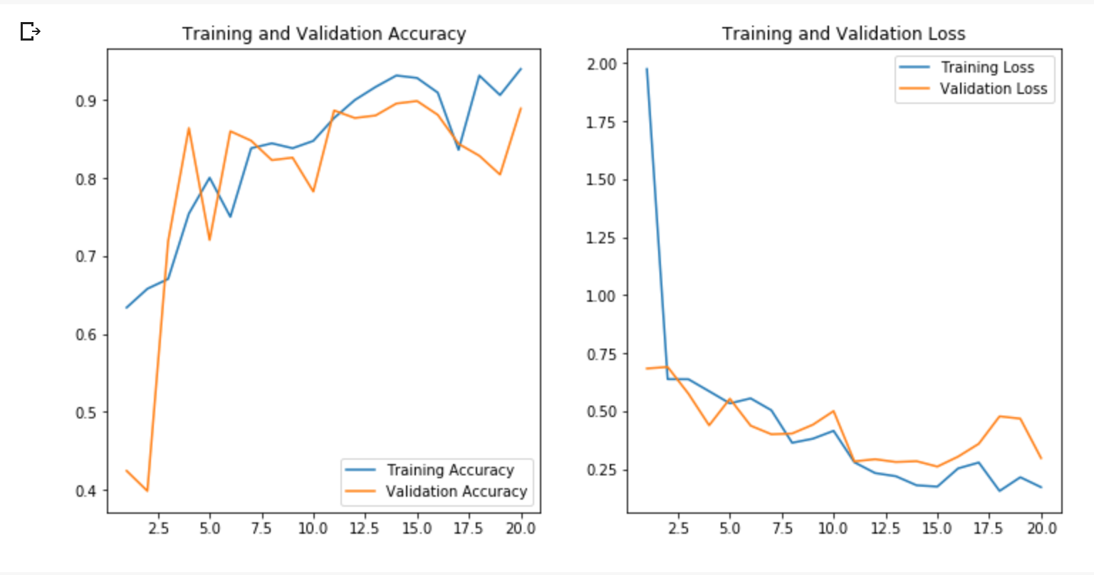
Model: Inception V3 | Zoom Level: 2 | Epochs: 20

Slide 21
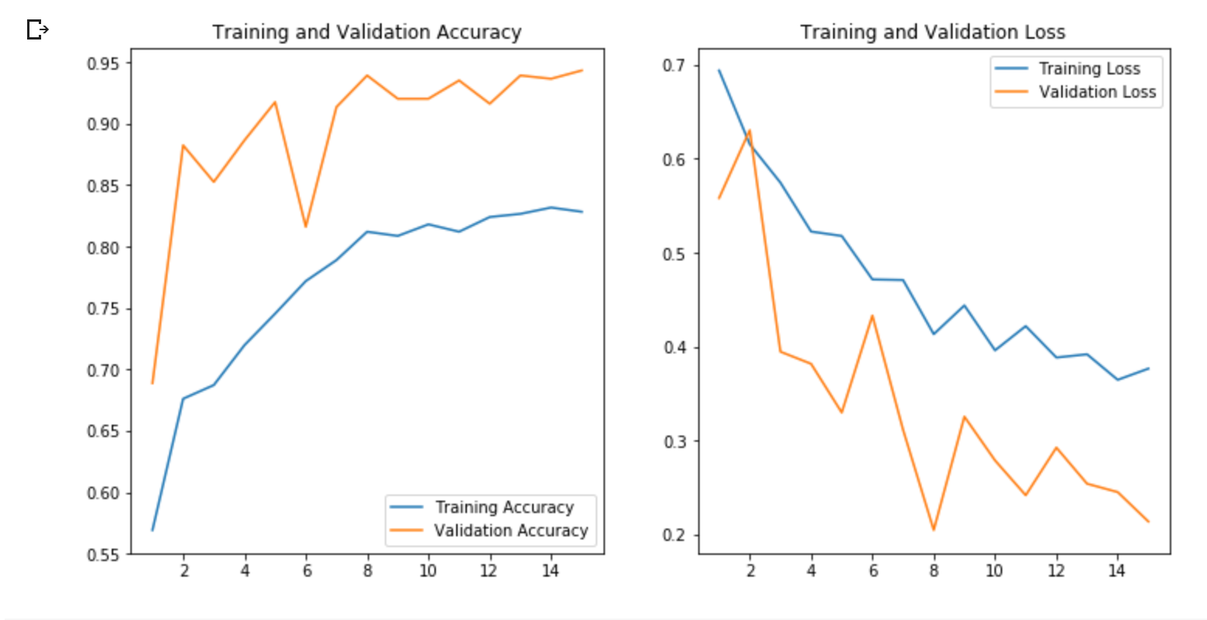
Model: Custom CNN | Zoom Level: 3 | Epochs: 15

Slide 22
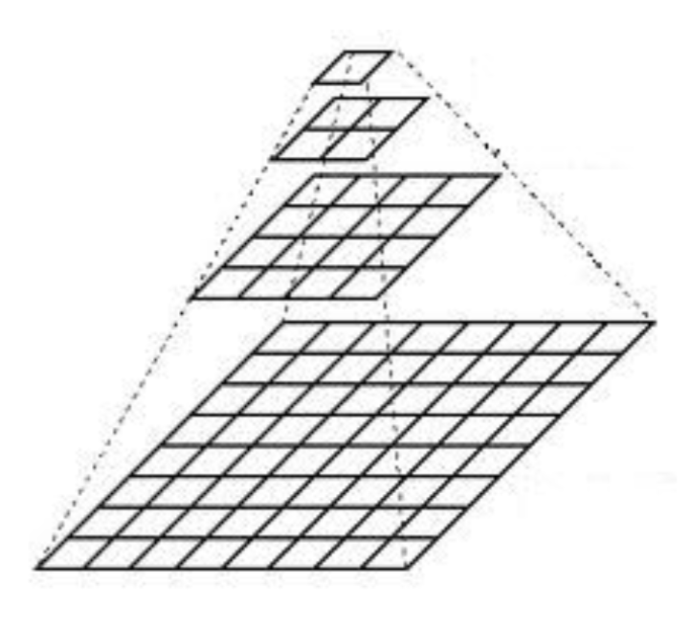
Multi-Zoom Model
299 x 299 sized patches
Zoom level 3 and Zoom level 4
Notes:
Next we wanted to try to combine two different zoom levels, as the paper did, to see if that would improve the accuracy of our predictions. This required us to regenerate new data from the existing slides. We decided to use patches from slides at zoom level 3 and 4. This is how we generated the data:
For every patch at zoom level 3, we find the coordinates (x,y) that it is centered on. We find the label for that patch, and then generate a 299 x 299 patch centered at the same (x,y) coordinates at zoom level 4. We do this for all windowed patches of zoom level 3.

Slide 23
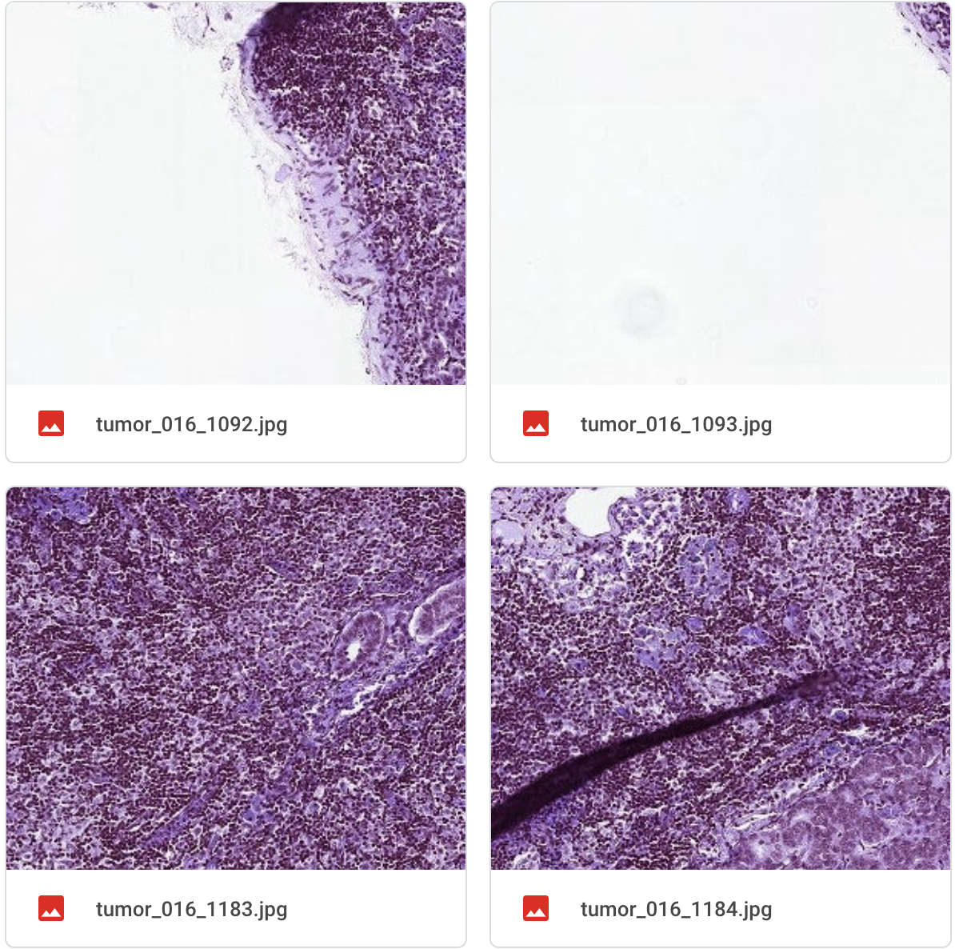
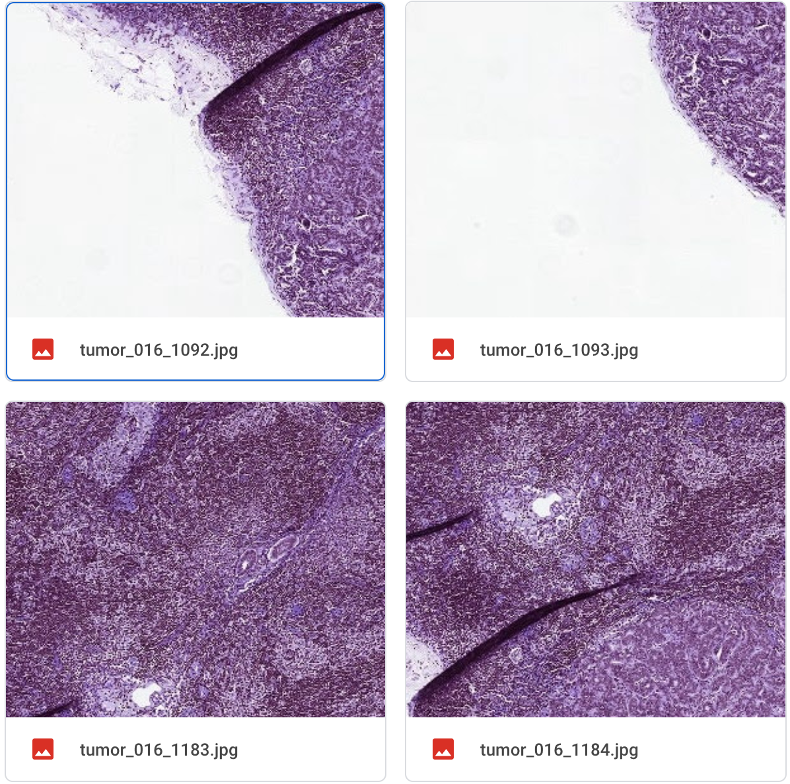
Zoom Level 3
Zoom Level 4
Notes:
This is a snippet of some of the patches that we generated. The grid of four patches on the left correspond to the patches at zoom level 3, and the right, at 4. As you can see, two patches that belong to the same pair, have the same name. So tumor016_1092 for zoom level 3 and 4 are centered at the same point on the slides, tumor016_1093 patch for level 3 and 4 is centered at the same point on the slides etc.
So the red squares correspond to roughty where the patches at the corresponding zoom level 3 are located.

Slide 24
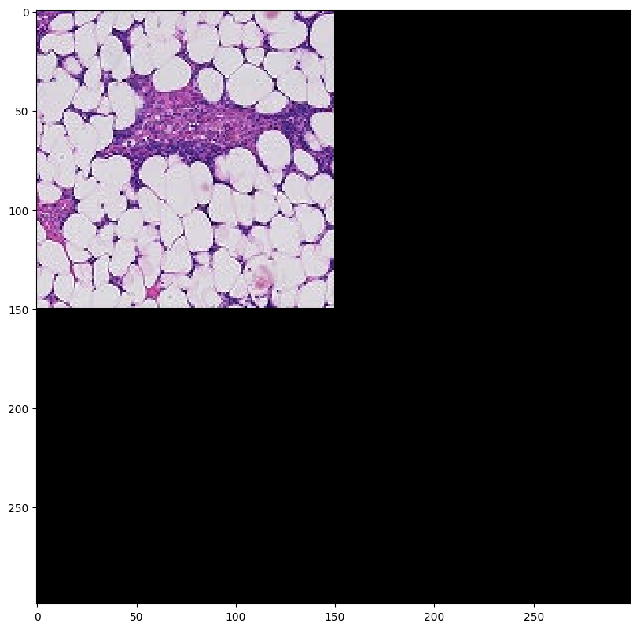
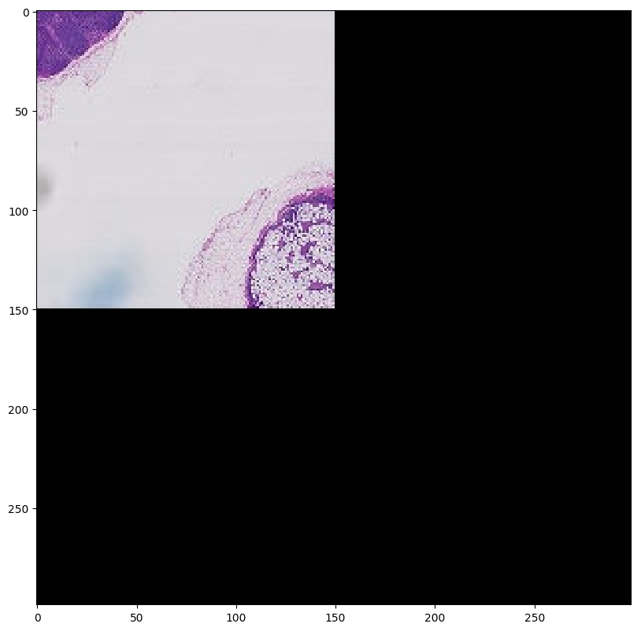
Multi-Zoom Model (Padding)
Notes:
One thing to note is how we created patches beyond the boundaries of the slide -- we did this by padding with zeros. Above is two patches generated at zoom level 0 and 7 centered right at the bottom right hand corner of a slide. Where the patch extends beyond the slide, the image is black, representing the padding.

Slide 25
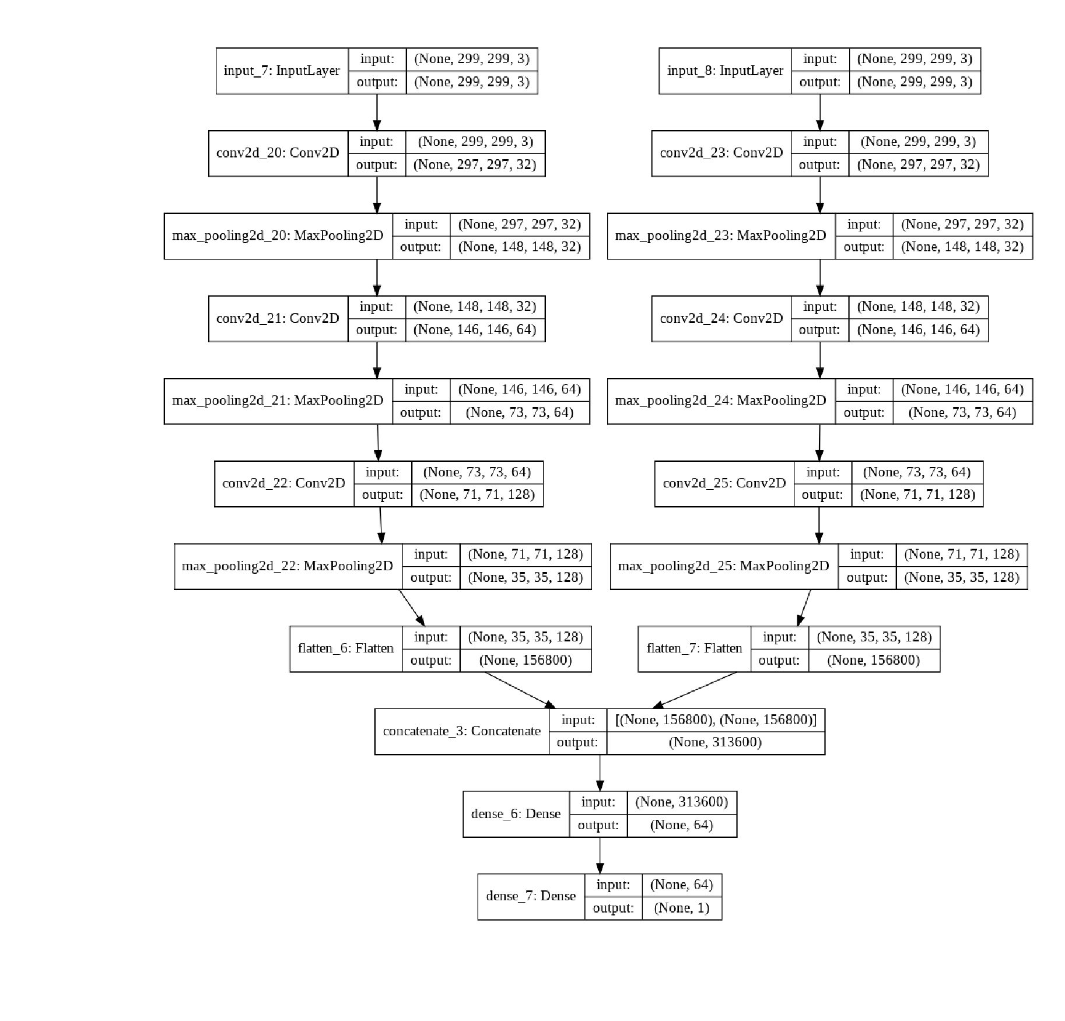
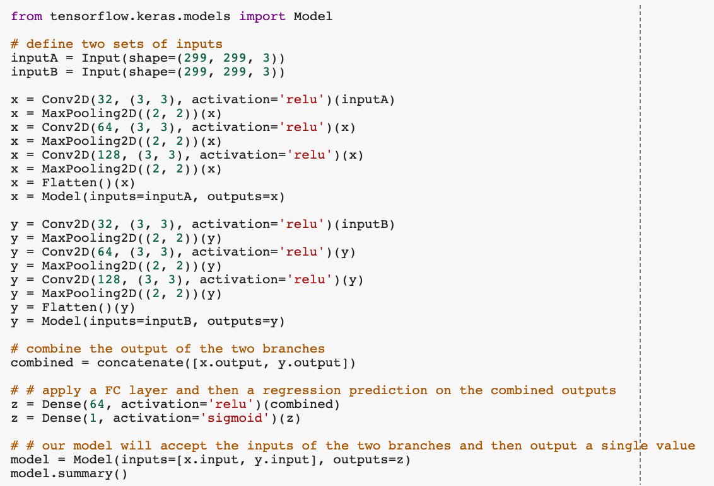
Multi-Zoom Model
Notes:
Moving on to the multi-zoom model. We decided to use our own smaller custom models for each sub-model, as we found that our own custom model provided better accuracies for true positives as compared to using a pre-trained model. Also, using smaller models would save us training time.
The two sub-models for each zoom level was constructed in the same way. Each sub-model took in image patches of size 299 by 299 as input, followed by a convolutional layer and max pooling layer with outputs 32, 64, then 128, topped off with a flatten layer. This flatten layer would then feed into the concatenate layer which combines the outputs from both models.
The final densely connected layer atop both models outputs 64 weights, and finally an output logit.

Slide 26
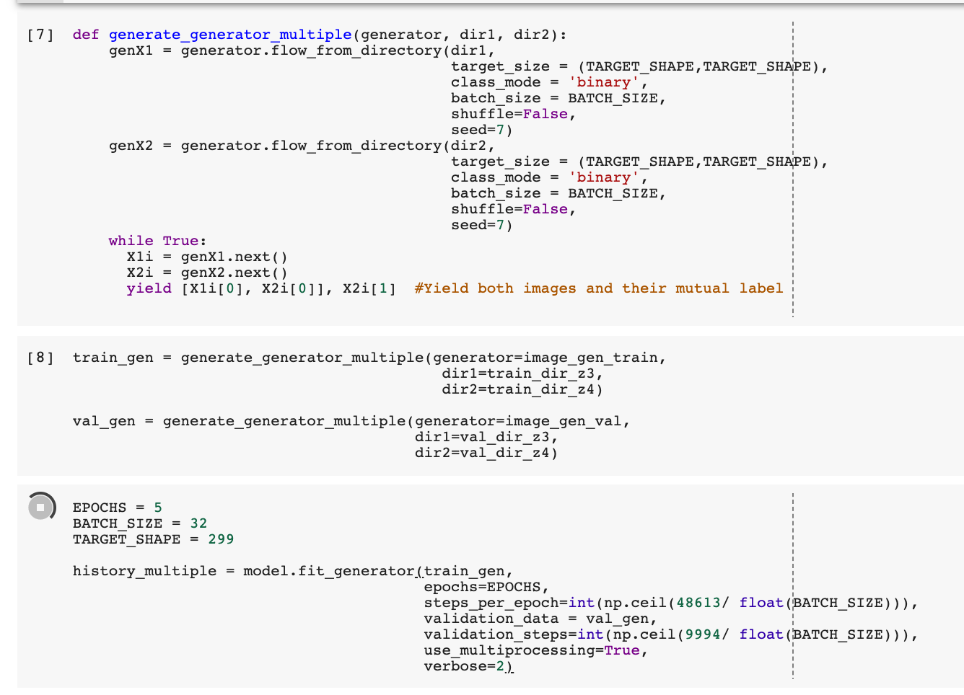
Multi-Zoom Model - Combining Two Generators
Notes:
Next, we had to combine both inputs. We had to create our own generator that outputs images from both generators as pairs, with their shared label.
The function generate_generator_multiple was taken from an example online, which takes in two directories corresponding to both images. Note that both directories have the same number of images, so that this works. Then, it outputs images in pairs, followed by their label.
We used this for both the training and validation data, so that our multi-input model works.

Slide 27
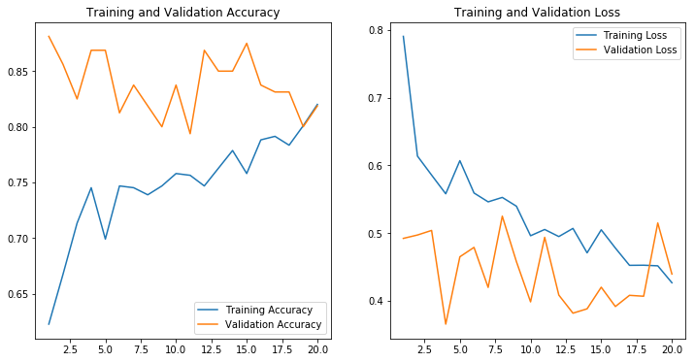
Multi-Zoom Model - Results
Notes:
After running our model over 20 epochs, this is the results we managed to get. Our validation accuracy hovers around 80 to 85%, and our loss around 0.45.
Similar to the paper, we found small or negligible improvements in our model when combining multiple zoom levels. However, this might also be due to the fact that our zoom levels were higher, and we used smaller sub-models.

Slide 28
Future works
Working with lower image levels (zoom level 0)
Hyperparameters fine-tuning
Sample weighting
Multi-scale approach (training models in parallel)
Alternative pre-trained model
MobileNet
Notes:
Going on to future works
We believe that the accuracy of our model could be increased more by using the slides at the lowest zoom level, zoom level 0. However, it took us more than 15 hours to generate this data and did not think it would be time-efficient for us to use data at this zoom level. However, given the proper equipment and better GPU, data at zoom 0 would be highly beneficial in improving the model.
We played with the hyperparameters and found that the current configuration gave us the most reliable result, but believe that giving more scrutiny to especially sample weighting could improve our accuracies specifically for true positives.
Also, our multi-zoom approach only used 2 zoom levels due to time constraints, but combining more than 2 zoom levels could also improve the accuracy of our model, though the original paper said that this only provided marginal improvements.
We also did not try alternative pretrained model, but stuck to the model that the paper deemed the most appropriate for our goal. However, it would be ideal to be able to experiment with other models such as MobileNet and VGG just to compare results.

